Slide 1

R FOR OFFICIAL STATISTICS
May 8, 2021
11:00 am - 1:00 pm (GMT +3)

Slide 2
Agenda
Time | Activity | Speaker/ Moderator
11:00 am – 11:05 am | Participants joining
11:05 am – 11:10 am | Welcoming remarks and introducing the speaker | Maggie Wanjiru
11:10 am – 12:25 pm | R for Official Statistics | Ngugi Mwenda
12:25 pm – 12: 55 pm | Q & A | Maggie Wanjiru and Faith Musili
12:55 pm – 13: 00 pm | Closing remarks | Maggie Wanjiru

Slide 3
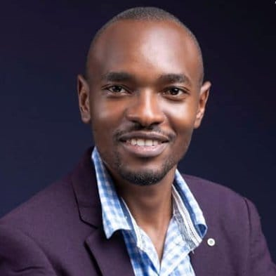
Our Trainer
Ngugi Mwenda
Statistician - Sampling Standards and Methods,
KNBS

Slide 4
Training Session

Slide 5
Q & A

Slide 6
THANK YOU
Email address: nairobi@rladies.org
LinkedIn: R-Ladies Nairobi
Twitter: @RLadiesNairobi
Meetup: https://www.meetup.com/rladies-nairobi/

